Slide 1


Slide 2
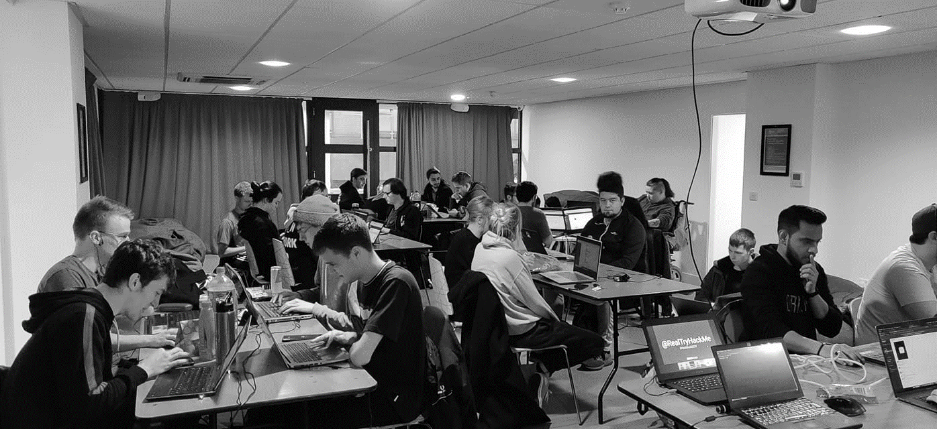



/dmuhackers
@dmuhackers
Introduction

Slide 3



Disclaimer
Don’t do illegal shit

Slide 4




Training Platforms
Tryhackme - Today
Hackthebox
Vulnhub
Cyberstart

Slide 5
Eternal Blue
Probably one of the most famous exploits ever
Affects windows servers using SMBv1
Officially named MS17-010 by microsoft
It was developed by the NSA as a cyberattack tool
Later leaked by Shadow Brokers
This box on tryhackme teaches you some basic pentesting practices and introduces you to metasploitable

Slide 6

Eternal Blue
https://tryhackme.com/room/blue

